Slide 1

Linear Regression
Mohammed Mowla

Slide 2
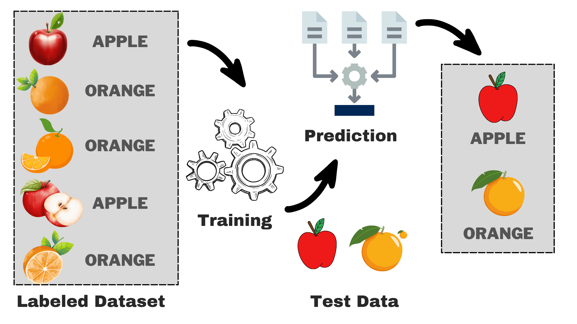
Supervised Learning
Supervised learning is a type of machine where the algorithm is trained on a labeled dataset.
The model ‘learns’ from the input-output (x, y) pairs to make predictions or decisions.
Types of Supervised Learning
- Classification: Predicting a categorical label - Regression: Predicting a continuous value

Slide 3
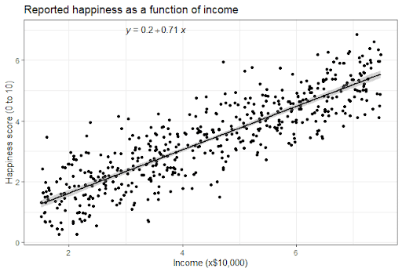
Linear Regression
Type of regression algorithm that is used when the relationship between the input variable(s) and the output is linear.
Aims to find the best-fit line that minimizes the difference between predicted and actual values.

Slide 4
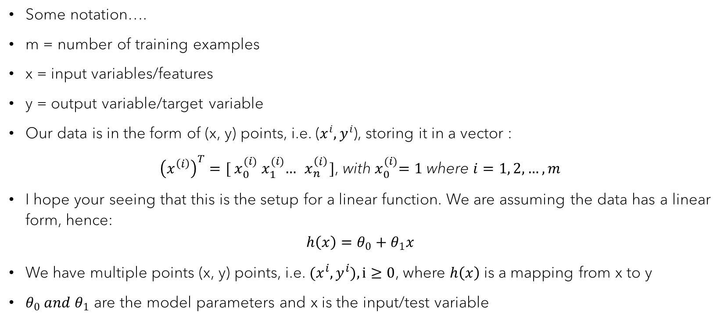
Linear Regression (Cont. 1)
Some notation….
m = number of training examples
x = input variables/features
y = output variable/target variable
Our data is in the form of (x, y) points, i.e. ($x^{i}, y^{i}$), storing it in a vector :
${\left(x^{\left(i\right)}\right)}^{T}={[ x}_{0}^{(i)}{ x}_{1}^{(i)}…{ x}_{n}^{\left(i\right)}]\text{,}$ with${ x}_{0}^{(i)}=1$ where $i=1, 2, …, m$
I hope your seeing that this is the setup for a linear function. We are assuming the data has a linear form, hence:
$$h\left(x\right)=θ_{0}+θ_{1}x$$
We have multiple points (x, y) points, i.e. $(x^{i}, y^{i}), i≥0$, where $h\left(x\right)$ is a mapping from x to y
$θ_{0} and θ_{1}$ are the model parameters and x is the input/test variable

Slide 5
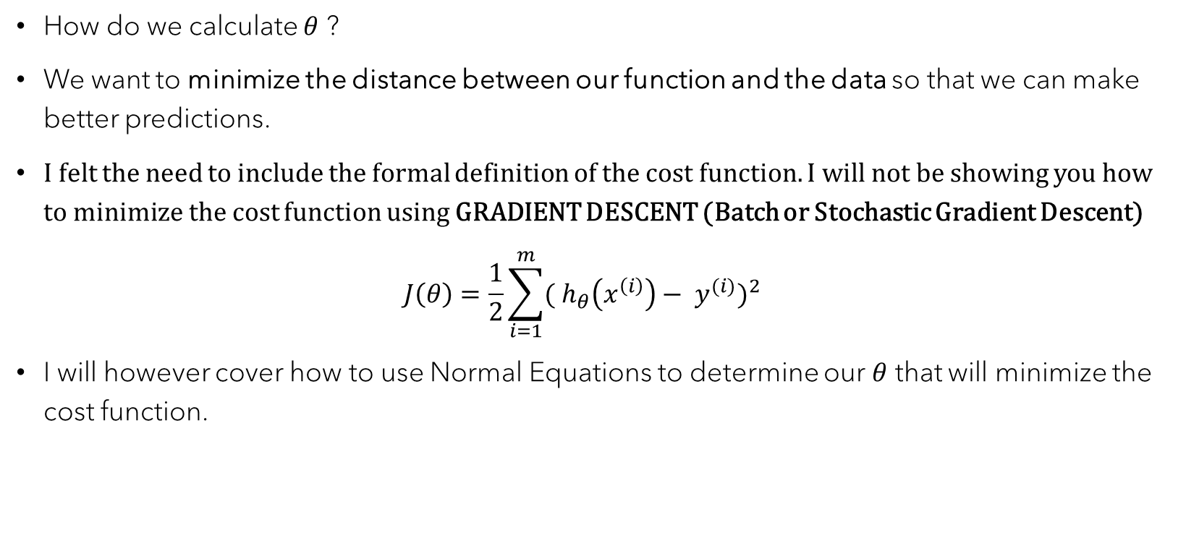
Linear Regression (Cont. 2)
How do we calculate $θ$ ?
We want to minimize the distance between our function and the data so that we can make better predictions.
I felt the need to include the formal definition of the cost function. I will not be showing you how to minimize the cost function using GRADIENT DESCENT (Batch or Stochastic Gradient Descent) $J\left(θ\right)=\frac{1}{2}\sum_{i=1}^{m}{{({ h}_{θ}\left(x^{\left(i\right)}\right)− y^{(i)})}^{2}}$
I will however cover how to use Normal Equations to determine our $θ$ that will minimize the cost function.

Slide 6

Linear Regression (Cont. 3)
Using the Normal Equation, we can directly solve for $θ$.
Recall that ${\left(x^{\left(i\right)}\right)}^{T}={[ x}_{0}^{(i)}{ x}_{1}^{(i)}…{ x}_{n}^{\left(i\right)}]\text{,}$ with${ x}_{0}^{(i)}=1$ with where $i=1, 2, …, m$ Create a design matrix $X$. Each row will represent a data point in the training sample. Each column will represent a feature. It includes a column of ones for the intercept term.
$$X=\left[\begin{aligned}_______{\left(x^{\left(1\right)}\right)}^{T}________ \\ _______{\left(x^{\left(2\right)}\right)}^{T}________ \\ .. \\ _______{\left(x^{\left(m\right)}\right)}^{T}________\end{aligned}\right]$$
- Our $y$ is the vector of target values.
$$y=\left[\begin{aligned}\left(y^{\left(1\right)}\right) \\ \left(y^{\left(2\right)}\right) \\ .. \\ \left(y^{\left(m\right)}\right)\end{aligned}\right]$$
Putting it all together, to solve for $θ$
$θ={{(X}^{T}X)}^{−1}$ $X^{T}$ $y$

